Slide 1
Programming Parallel Hardware using MPJ Express
By A. Shafi

Slide 2
Why Java?
Portability
A popular language in colleges and software industry:
Large pool of software developers
A useful educational tool
Higher programming abstractions including OO features
Improved compile and runtime checking of the code
Automatic garbage collection
Support for multithreading
Rich collection of support libraries

Slide 3

MPJ Express
MPJ Express is an MPI-like library that supports execution of parallel Java applications
Three existing approaches to Java messaging:
Pure Java (Sockets based)
Java Native Interface (JNI)
Remote Method Invocation (RMI)
Motivation for a new Java messaging system:
Maintain compatibility with Java threads by providing thread-safety
Handle contradicting issues of high-performance and portability
Requires no change to the native standard JVM

Slide 4
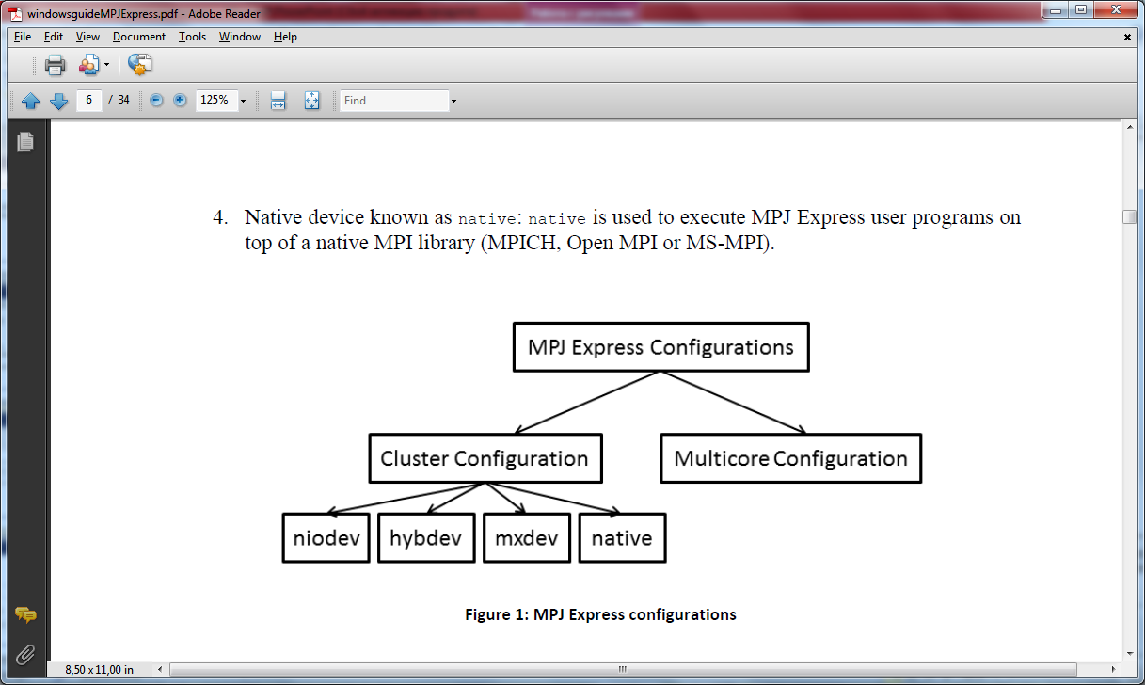
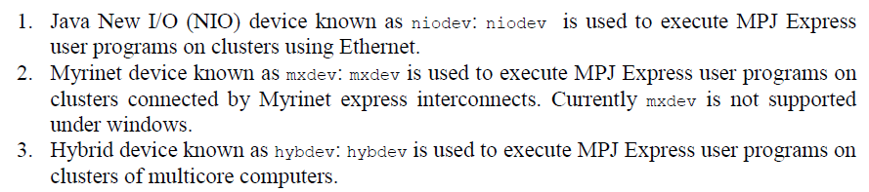
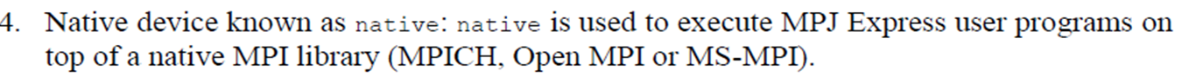
MPJ Express configuration

Slide 5
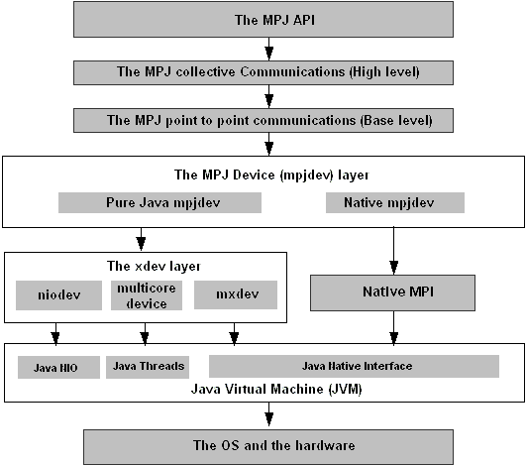
MPJ Express Design

Slide 6
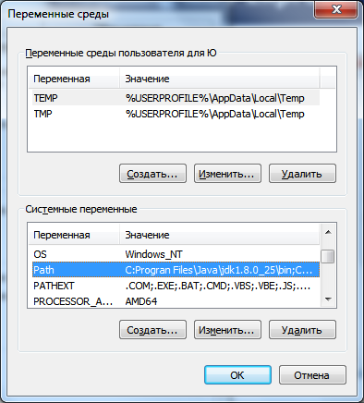
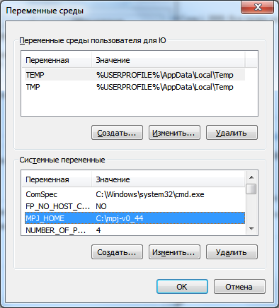
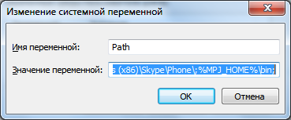
Installing MPJ Express
Керуйтесь вказівками з документації у відповідності до операційної системи http://mpjexpress.org/guides.html
Приклад для Windows:

Slide 7
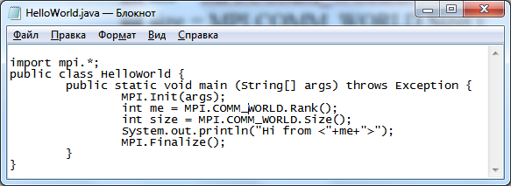
HelloWorld program

Slide 8
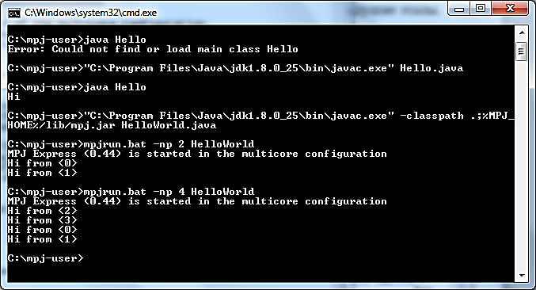
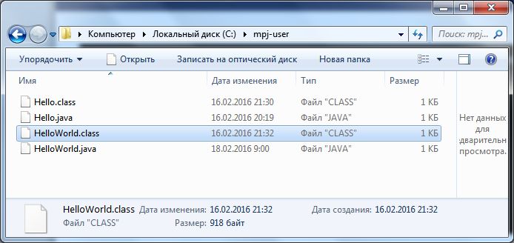
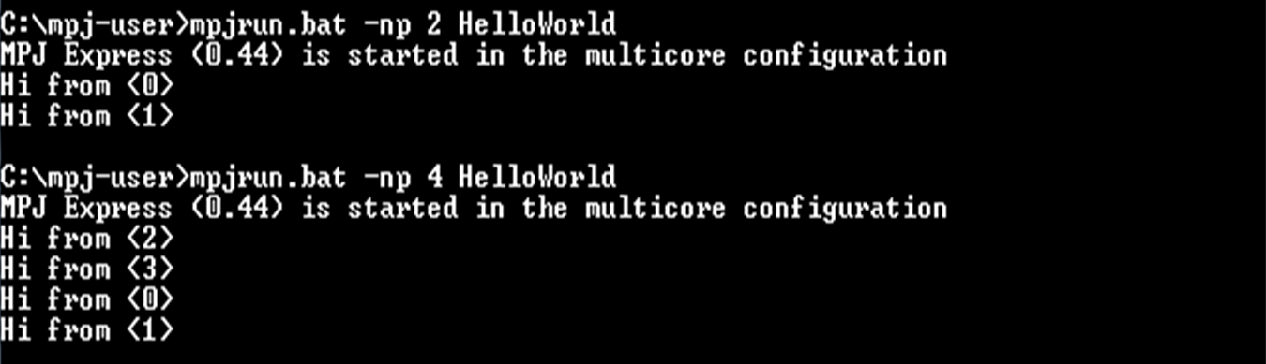
HelloWorld program

Slide 9
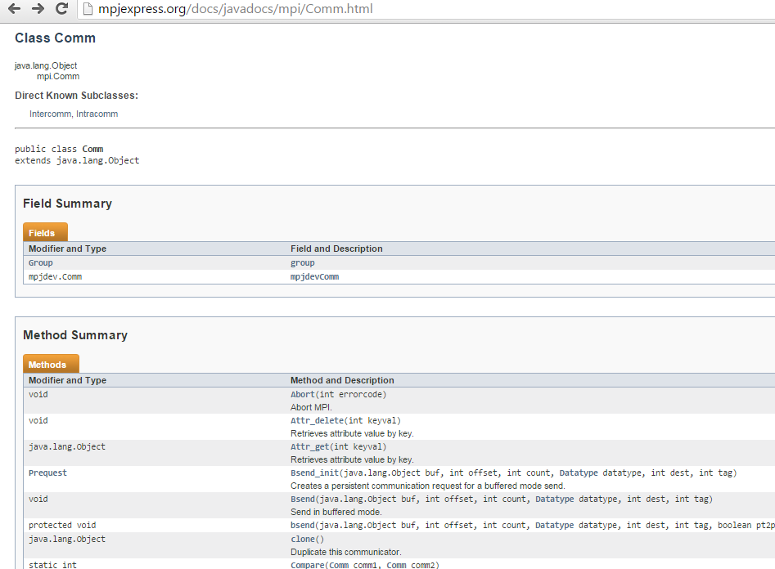
Documentation: class Comm

Slide 10
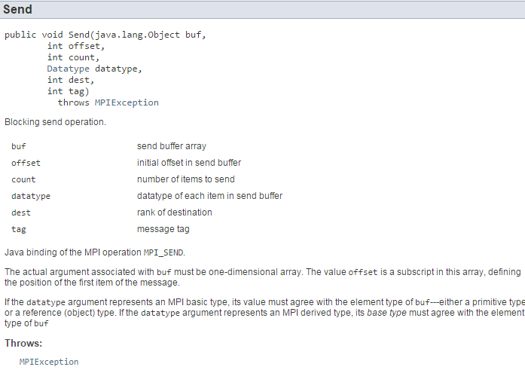
Documentation: Send() method

Slide 11
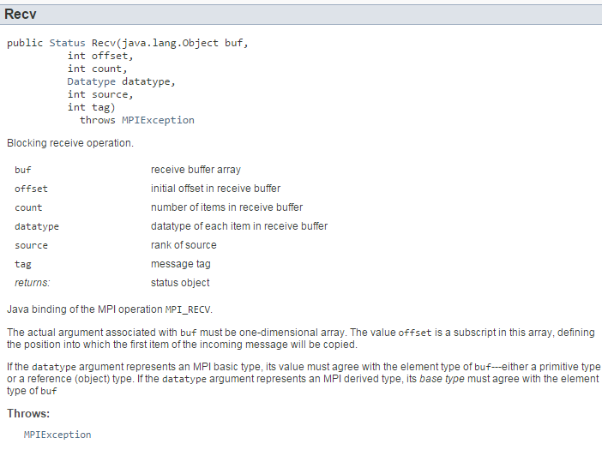
Documentation: Recv() method

Slide 12
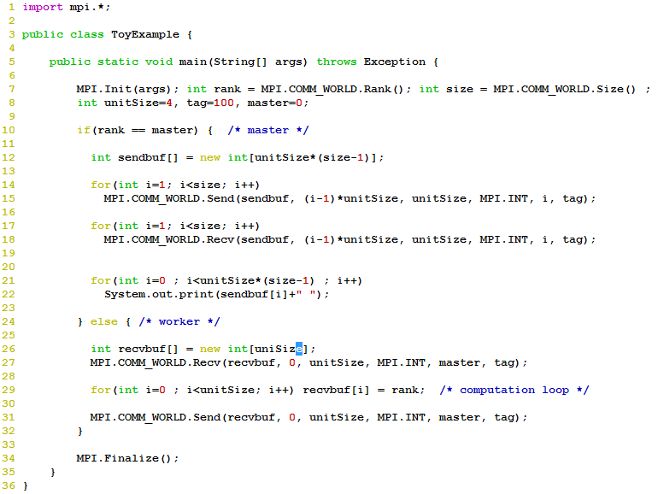
aamirshafi@velour:~/work/mpj-user$ mpjrun.sh -np 5 ToyExample
MPJ Express (0.38) is started in the multicore configuration
1 1 1 1 2 2 2 2 3 3 3 3 4 4 4 4

Slide 13
Point-to-point Communication
 | Standard | Synchronous | Ready | Buffered
Blocking | Send() Recv() | Ssend() | Rsend() | Bsend()
Non-blocking | Isend() Irecv() | Issend() | Irsend() | Ibsend()
Non-blocking methods return a Request object:
Wait() //waits until communication completes
Test() //test if the communication has finished

Slide 14
Collective communications
Provided as a convenience for application developers:
Save significant development time
Efficient algorithms may be used
Stable (tested)
Built on top of point-to-point communications

Slide 15
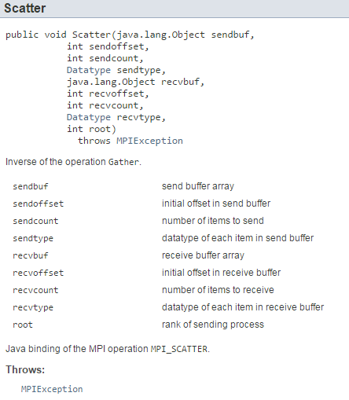
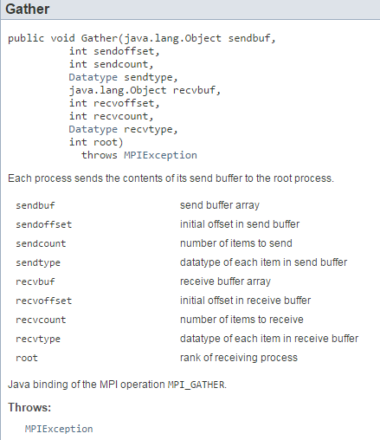
Documentation: Scatter(), Gather() methods

Slide 16
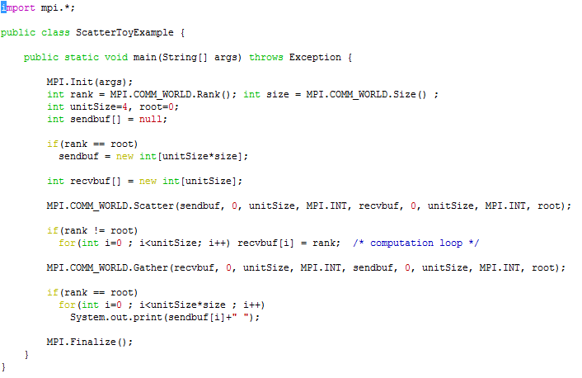
Toy Example with Collectives

Slide 17
Thread-safe Communication
Thread-safe MPI libraries allow communication from multiple user threads inside a single process
Such an implementation requires fine-grain locking:
Incorrect implementations can deadlock
Levels of Thread-Safety in MPI Libraries
MPI_THREAD_SINGLE : only one thread will execute
MPI_THREAD_FUNNELED : may be multi-threaded, but only the main thread will make MPI calls
MPI_THREAD_SERIALIZED : may be multi-threaded, but only the one thread will make MPI calls at a time
MPI_THREAD_MULTIPLE : multiple threads may call MPI with no restrictions

Slide 18
Performance Evaluation of Point to Point Communication
Normally ping pong benchmarks are used to calculate:
Latency: How long it takes to send N bytes from sender to receiver?
Throughput: How much bandwidth is achieved?
Latency is a useful measure for studying the performance of “small” messages
Throughput is a useful measure for studying the performance of “large” messages
RTT!
Node A
Node B

Slide 19
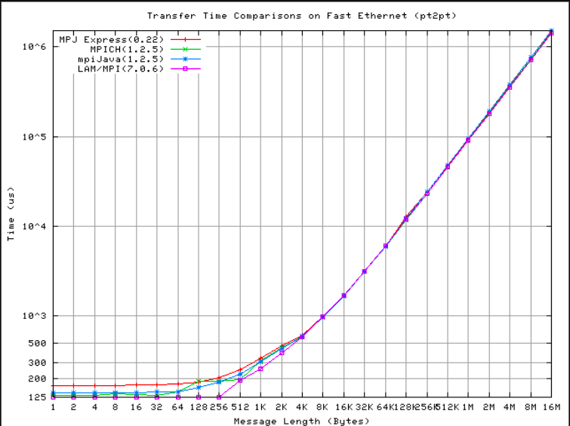
Latency Comparison

Slide 20
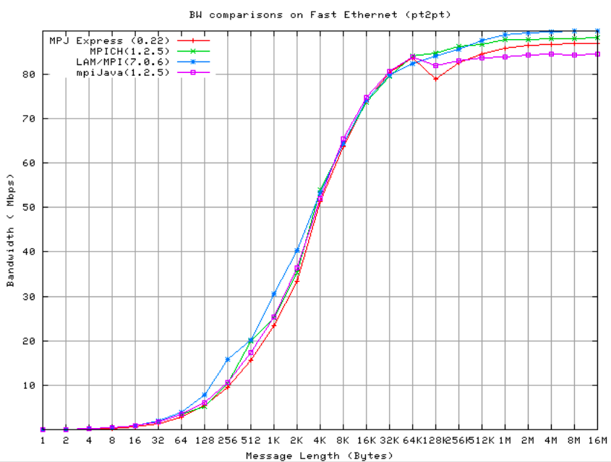
Throughput Comparison

Slide 21
Документація
Програмне забезпечення MPJ Express та його документація доступні за посиланням http://mpjexpress.org/documentation.html
Особливості завантаження дивіться у відповідних вказівках до ПЗ http://mpjexpress.org/guides.html

